Slide 1
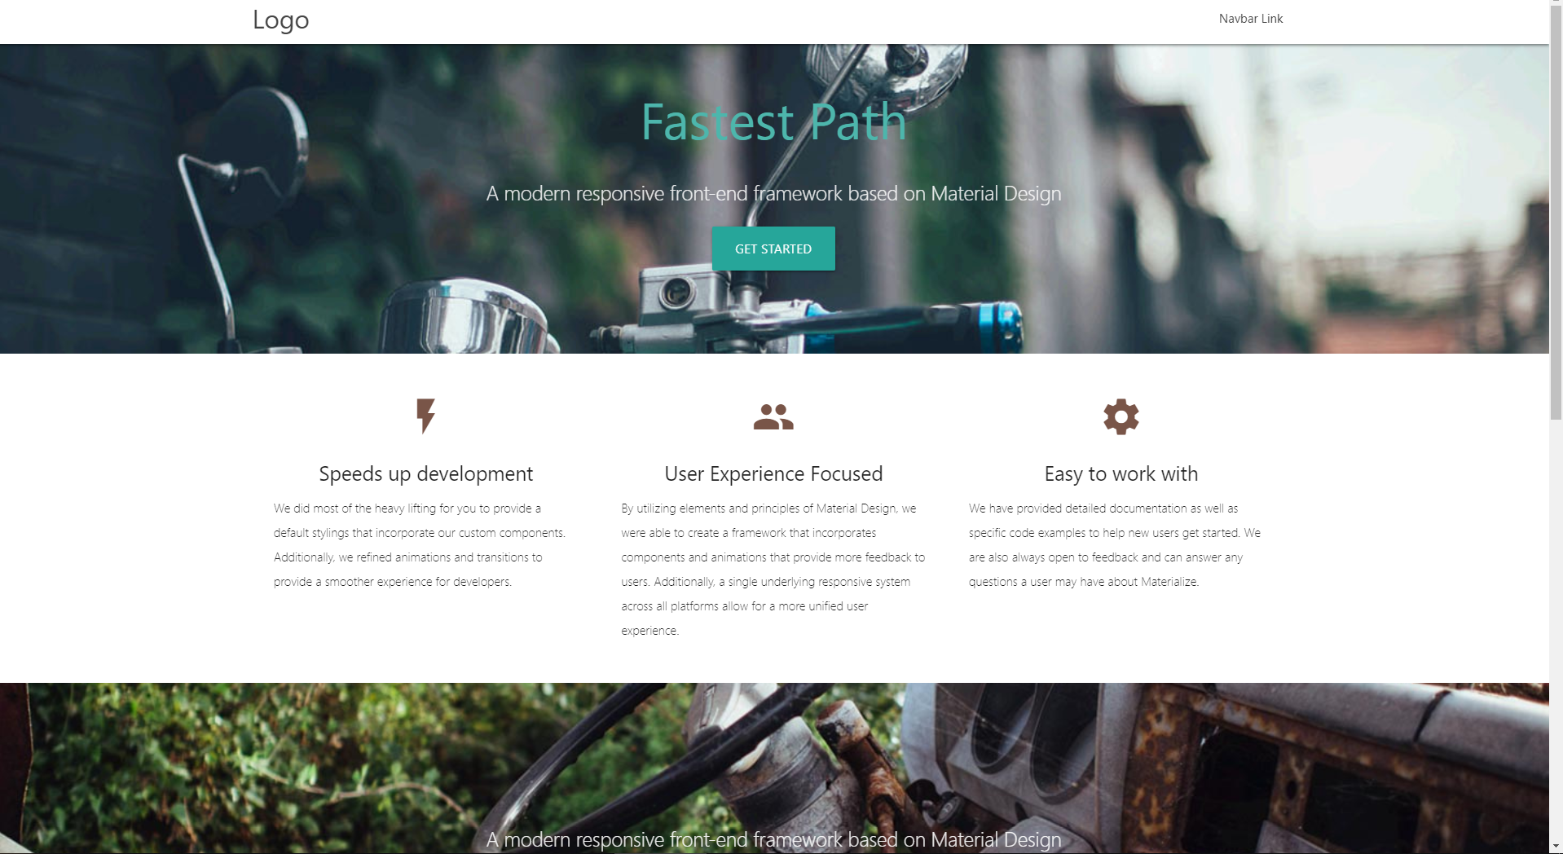
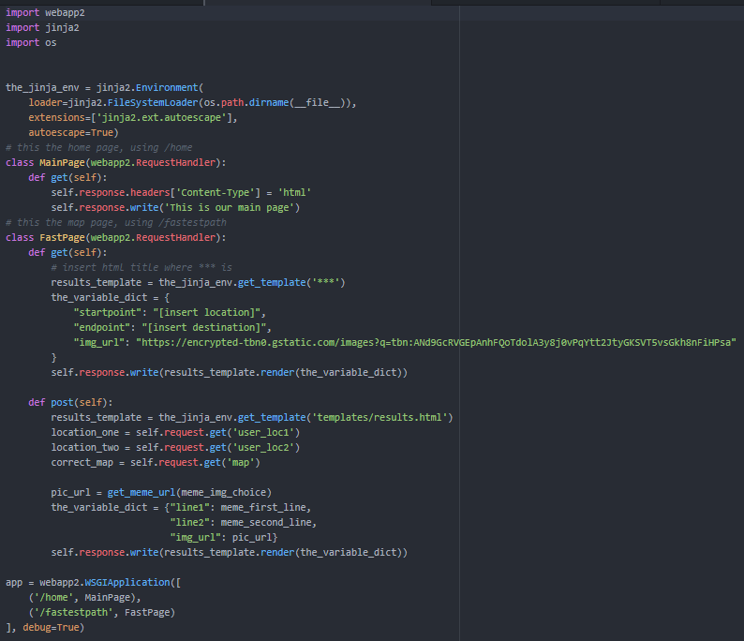
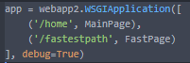
Day1M-Team 3: Fastest Path
Front End
Back End
Created Parallax Template ;)

Slide 2
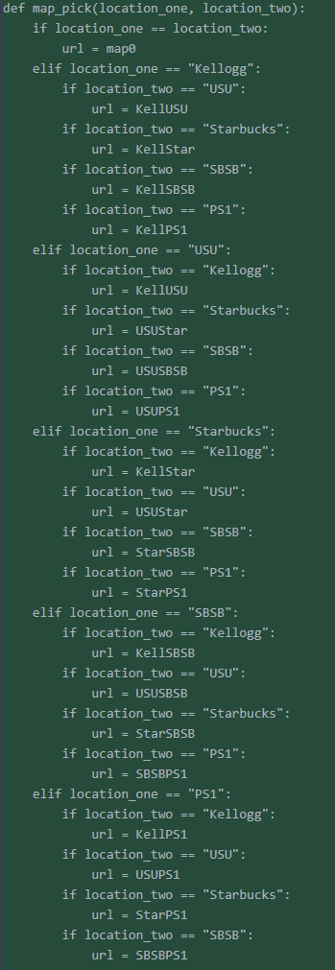
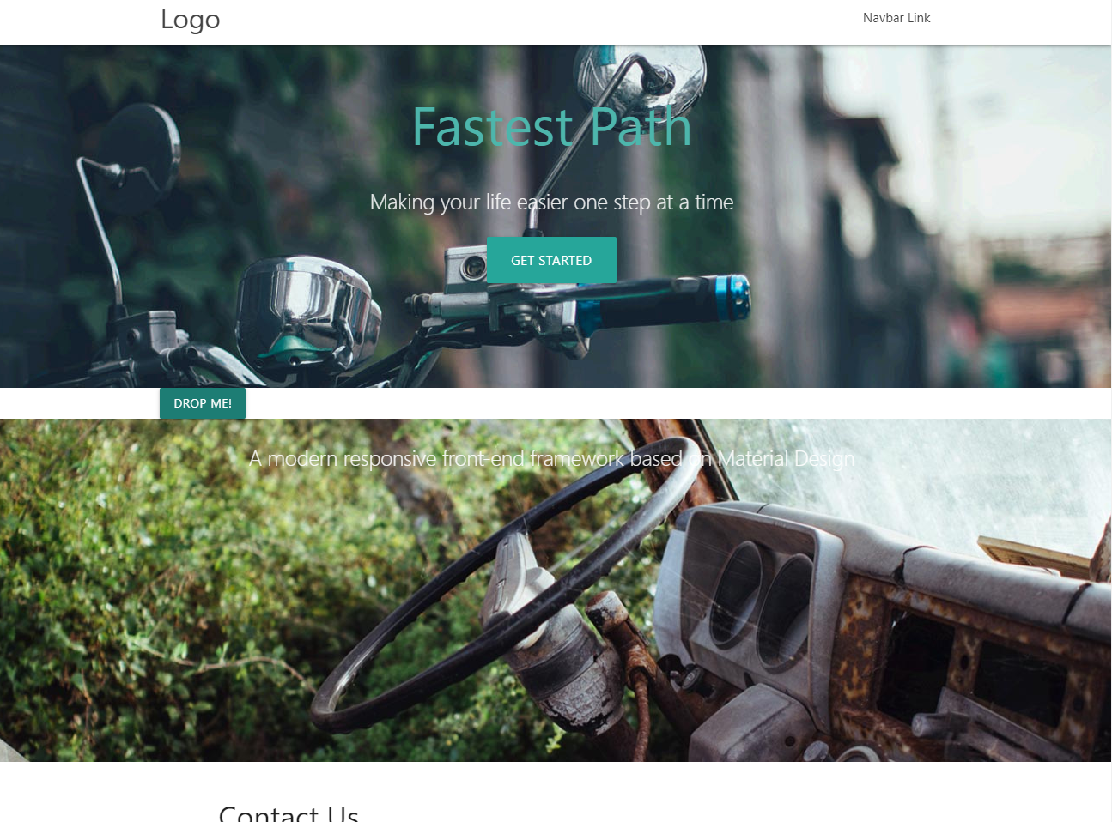
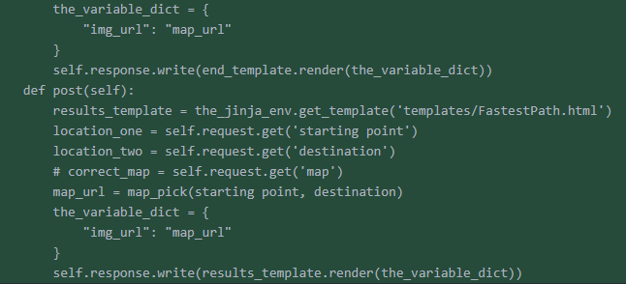
Day1A-Team 3: Fastest Path
Front End
Back End
Fixing Drop down menu

Slide 3
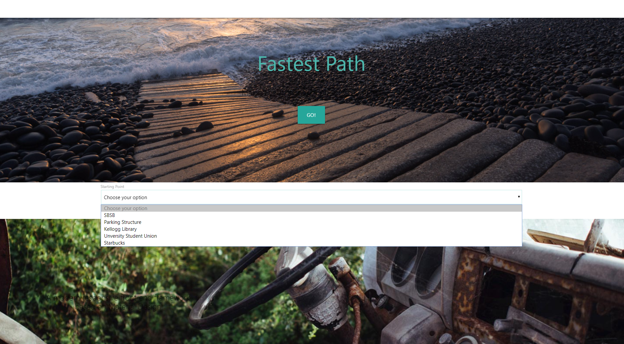
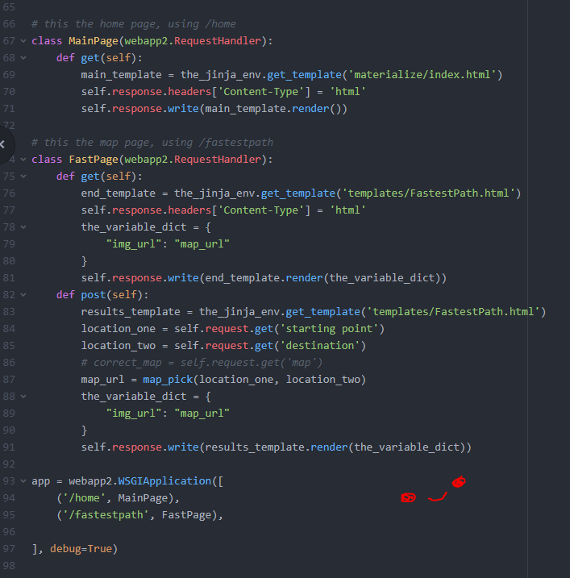
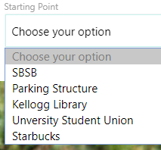
Day2M-Team 3: Fastest Path
Front End (Melissa & Francisco)
Back End (Uma & Marc)
Worked on the post and get requests
Fixed Drop down menu :D

Slide 4
Day2A-Team 3: Fastest Path
Front End (Melissa & Francisco)
Back End (Uma & Marc)
Worked on the post and get requests
Fixed Drop down menu :D

Slide 5
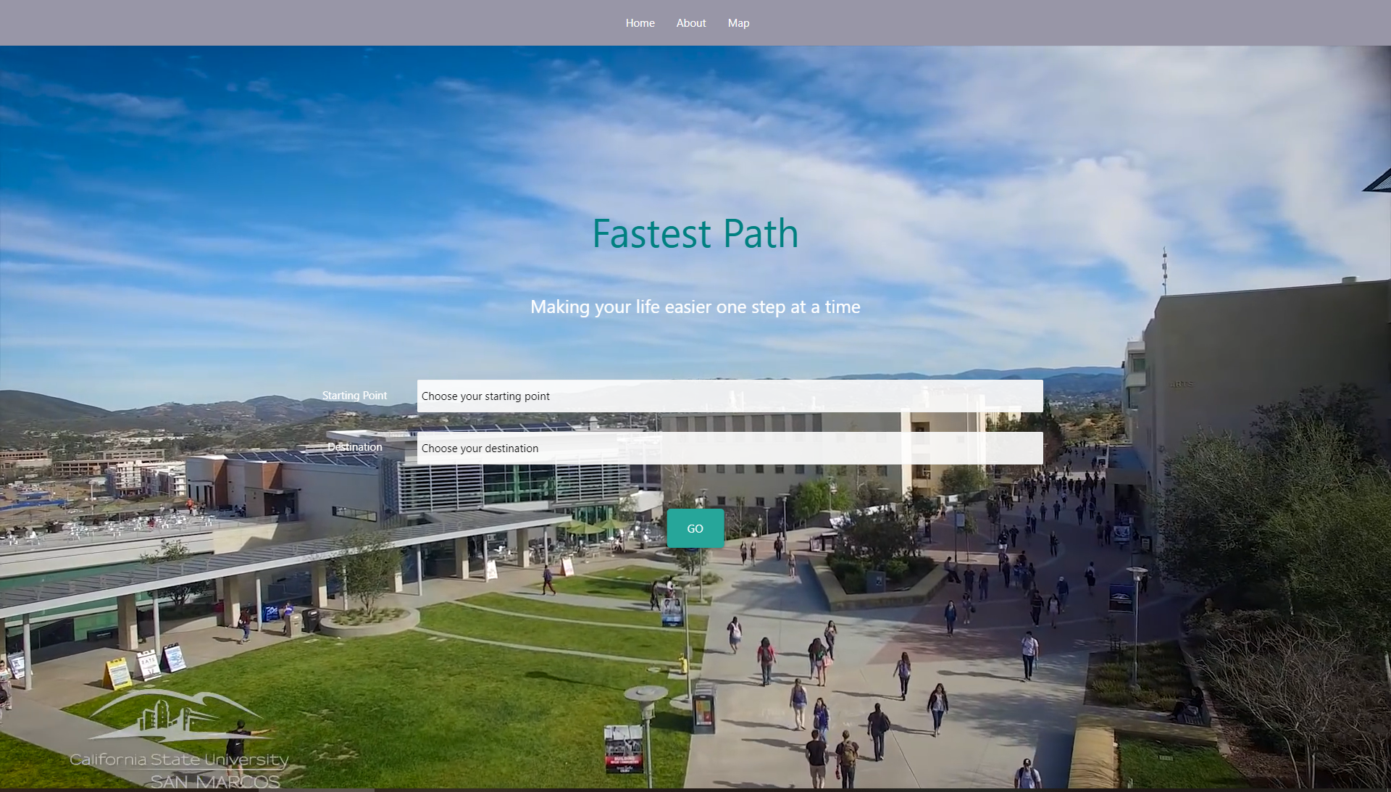
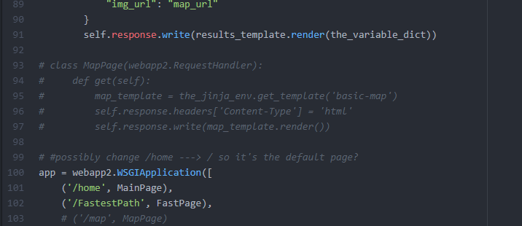
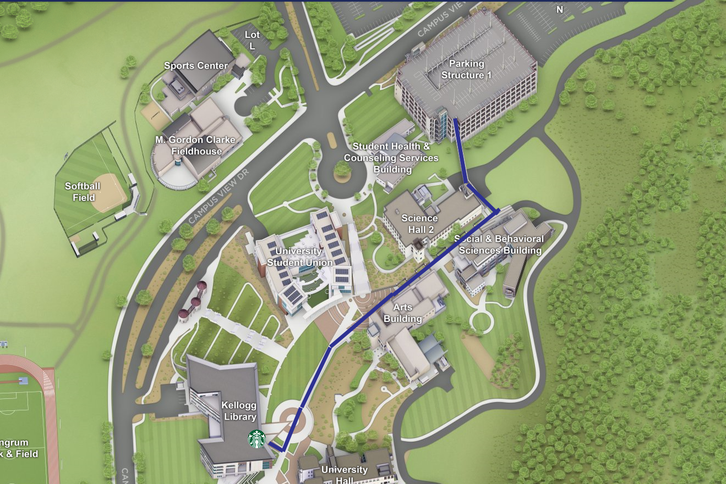
Day3M-Team 3: Fastest Path
Front End (Melissa & Francisco)
Back End (Uma & Marc)
Reformatted the page ☺
Setup for the map page

Slide 6
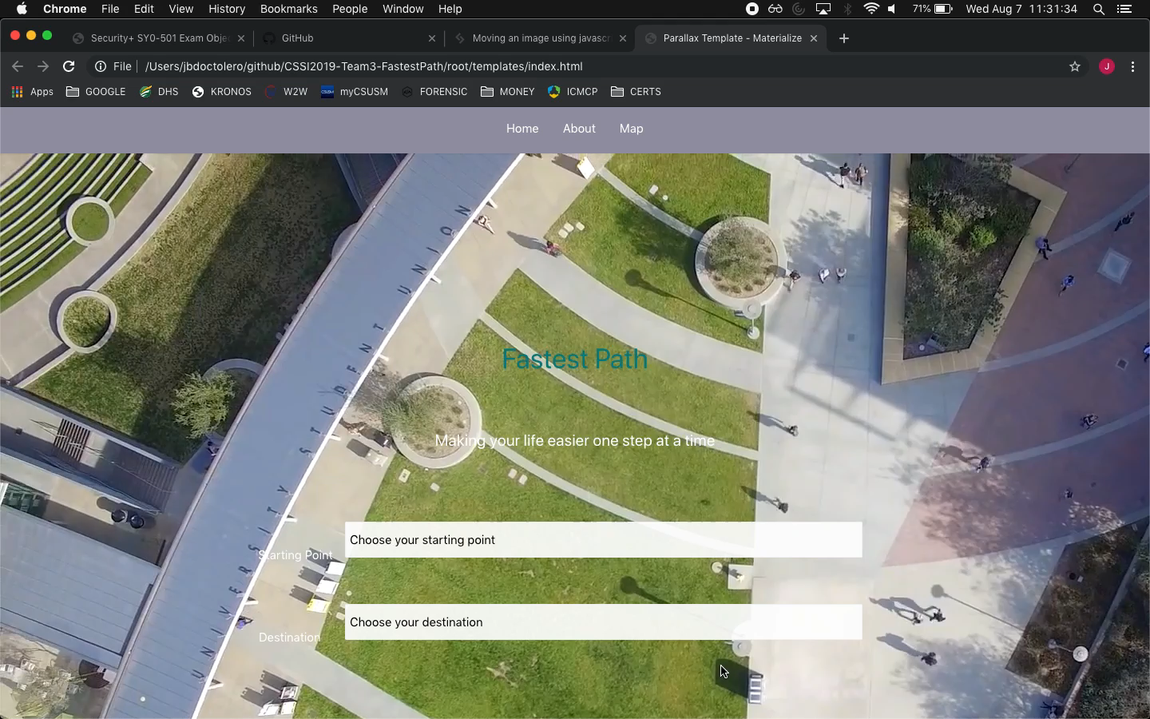
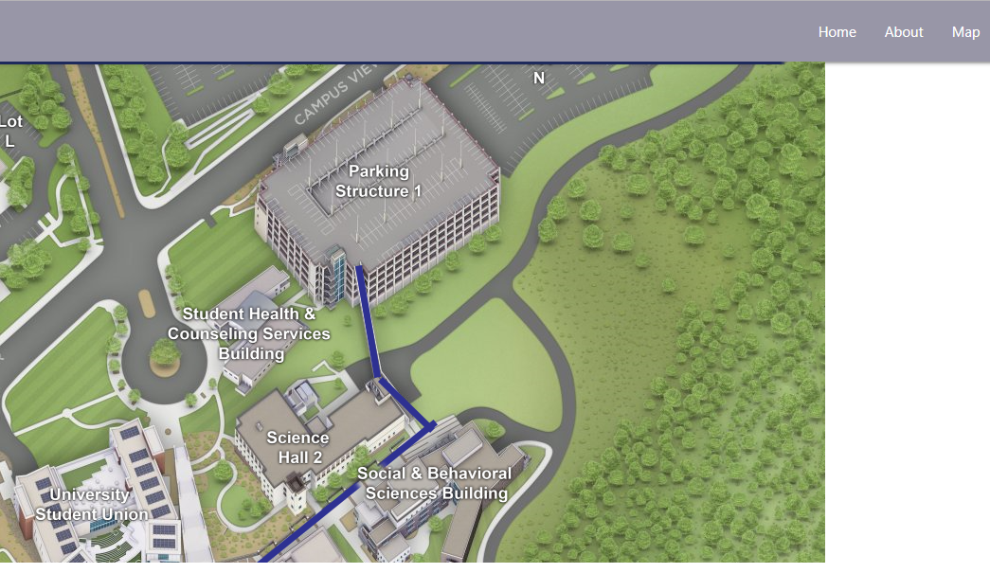
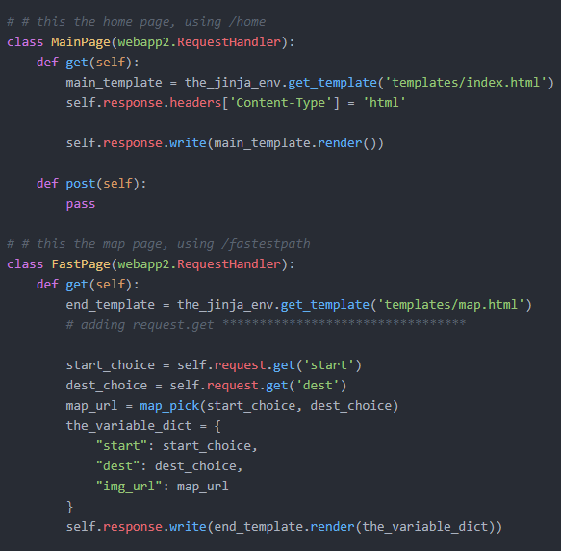
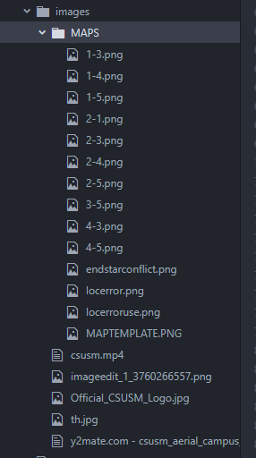
Day3A-Team 3: Fastest Path
Front End (Melissa & Francisco)
Back End (Uma & Marc)
The map page
Everything is coming together ☺

Slide 7
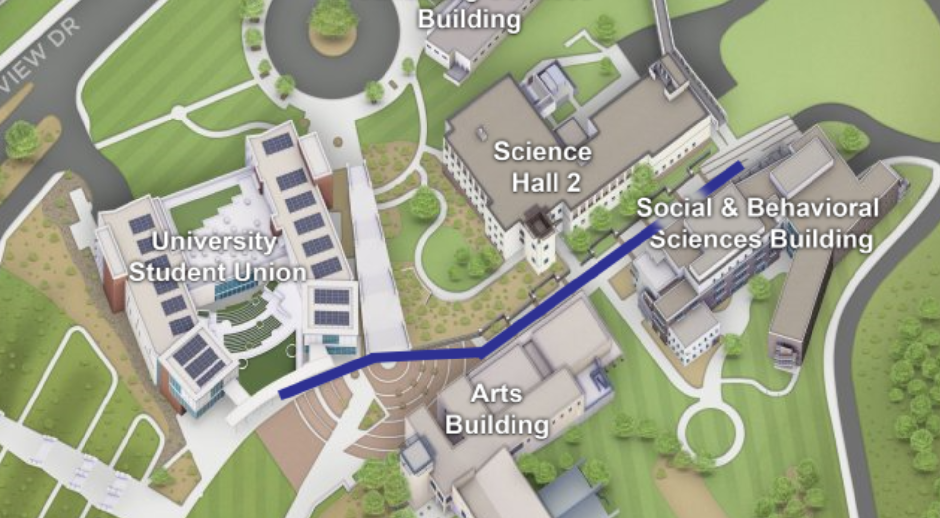

Day4M-Team 3: Fastest Path http://fastestpath.appspot.com/
Front End (Melissa & Francisco)
Back End (Uma & Marc)
Everything is coming together ☺
Map complete ☺

Slide 8
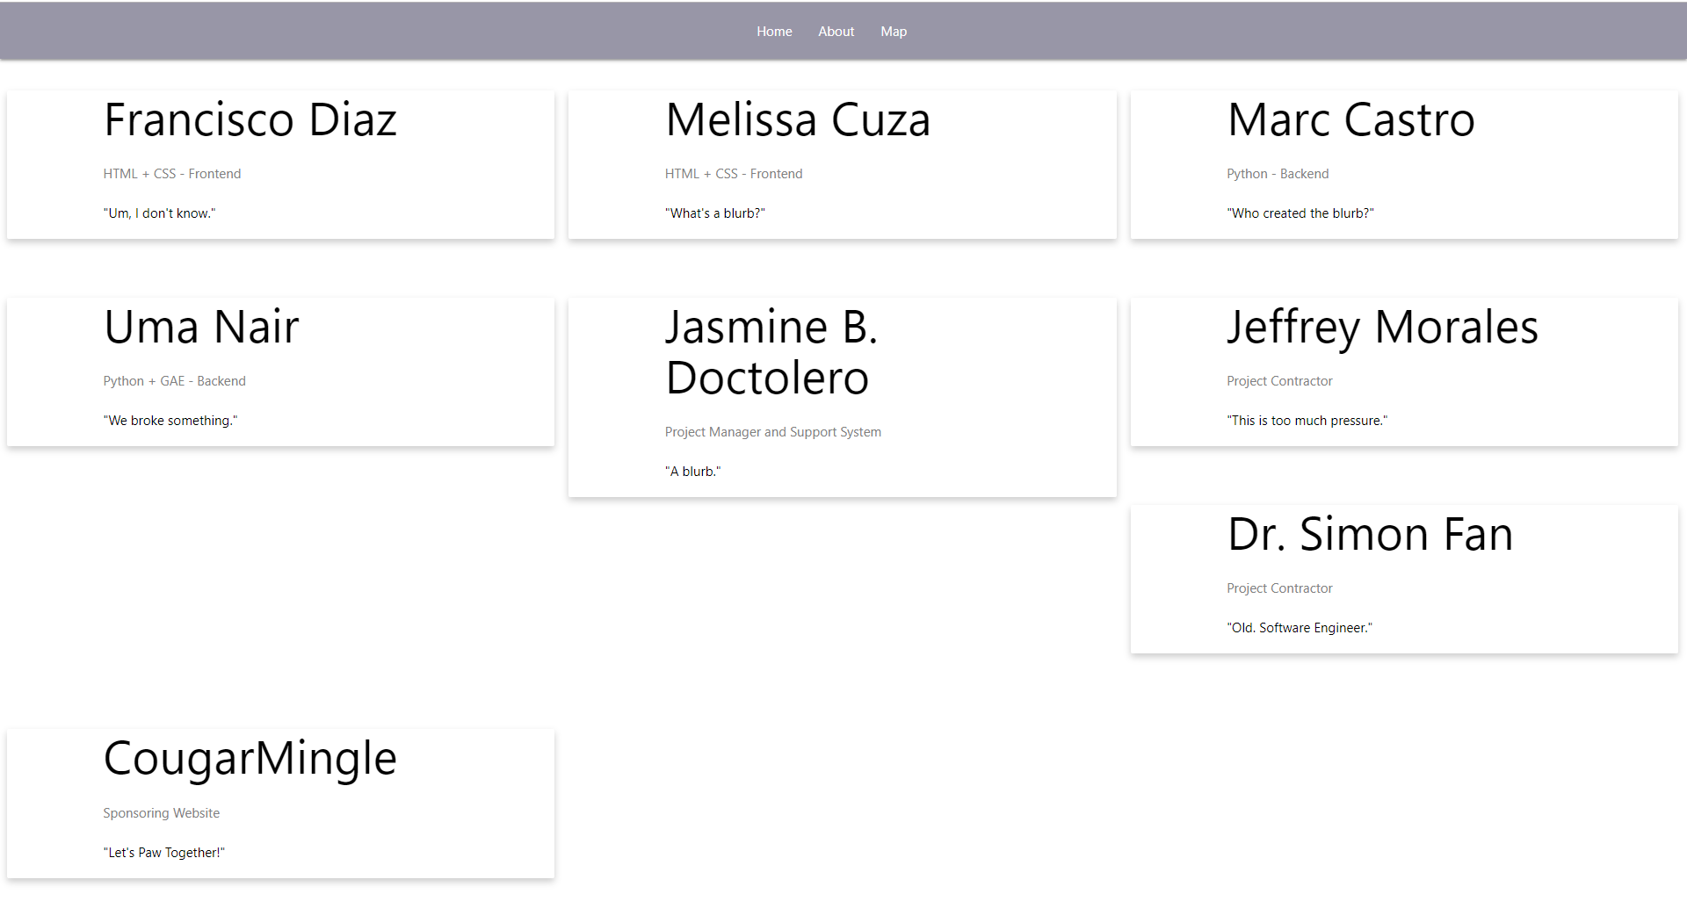
Day4A-Team 3: Fastest Path http://fastestpath.appspot.com/
Front End (Melissa & Francisco)
Back End (Uma & Marc)
Frontend Basically Complete ☺
About Page Complete ☺

